Slide 1
Automated Infrastructure Provisioning and Containerized deployment of an AI-Based Non-Profit Support Triage Agent
IaC Provisioning for Non-Profit System
Date:18-03-2026
Neha Tamboli
EN22CS301641
Riddhima Taose
EN22CS303042
Uday Patidar
EN23CS3L1023
Rohan Rawat
EN23CS3l1026
Naman Dwivedi
EN22CS301627

Slide 2
Description
This project focuses on developing and deploying an AI-powered Non-Profit Support Triage System using DevOps practices and Infrastructure as Code principles. The system is designed to automatically analyze and process incoming communication messages from donors, volunteers, and beneficiaries. Using Natural Language Processing and Large Language Models, the application classifies messages based on urgency and intent, extracts important entities such as names or donation amounts, and generates appropriate response drafts. To ensure reliable deployment and consistent system environments, the application is containerized using Docker and orchestrated through Docker Compose and Kubernetes. DevOps tools such as Git and Jenkins or GitHub Actions are used to automate version control, build processes, and deployment pipelines. This approach eliminates manual configuration errors, improves scalability, and enables efficient management of communication workflows in non-profit organizations.

Slide 3
Builds and Package: Use a multi-stage Dockerfile to create a lightweight, secure, and optimized container image for the AI-powered Non-Profit Support Triage application, including the Streamlit interface and AI processing modules.
Orchestrate Services: Deploy the triage system and supporting services using Docker Compose to ensure smooth communication between the application, AI agents, and data storage components.
Ensure Consistency: Maintain identical development and deployment environments across the entire team using containerization and Infrastructure as Code to eliminate configuration mismatches.
Enhance Security & Scalability: Run the AI triage system in a secure containerized environment designed for high performance, portability, and scalable deployment using modern DevOps practices.

Slide 4
Tools and Technology
Frontend (Client-Side Technologies):
Streamlit – Provides an interactive web interface for submitting and analyzing non-profit support messages. HTML5 – Used for structuring the web application interface. CSS3 – Enhances the visual appearance and layout of the user interface. JavaScript – Adds interactivity and improves user experience within the application dashboard.

Slide 5
B. Backend (Python-based) & Database:
Python – Core programming language used for building the AI-powered triage system. LangChain – Used for orchestrating AI agents and managing interactions with large language models. LLM APIs – Used for message classification, entity extraction, and response generation. ChromaDB – Vector database used to store embeddings and perform semantic search operations. Pandas – Used for data processing, analysis, and transformation.

Slide 6
C. Containerization & Orchestration:
Docker – Used to containerize the application for consistent deployment. Multi-Stage Dockerfile – Optimizes container image size and enhances security. Docker Compose – Manages multiple containers and service communication. Kubernetes – Provides container orchestration and scalable deployment. Git & GitHub – Used for version control and collaborative development.

Slide 7
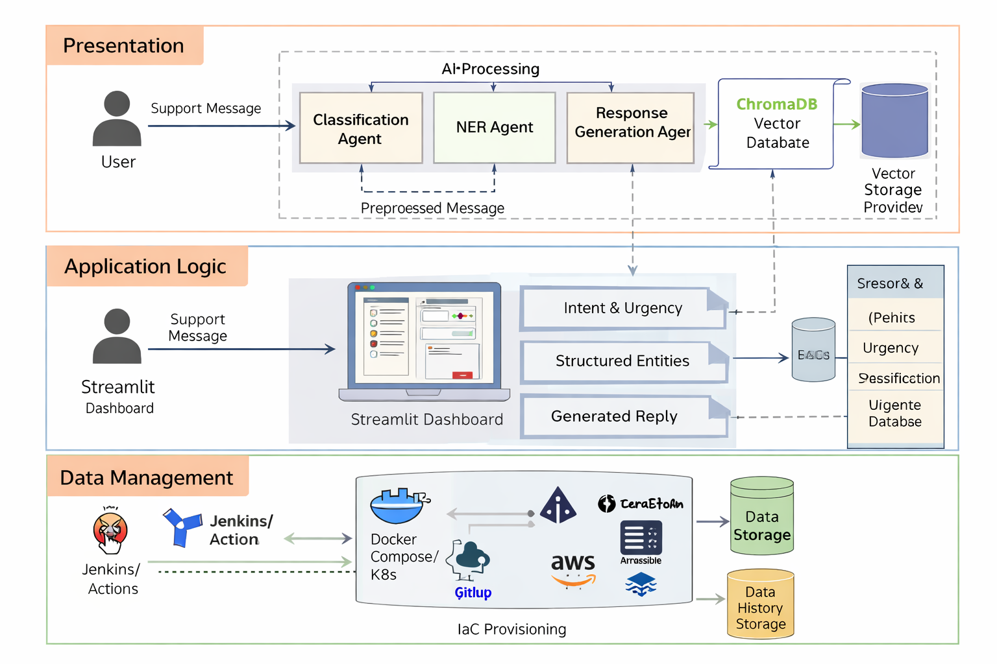
LLD

Slide 8
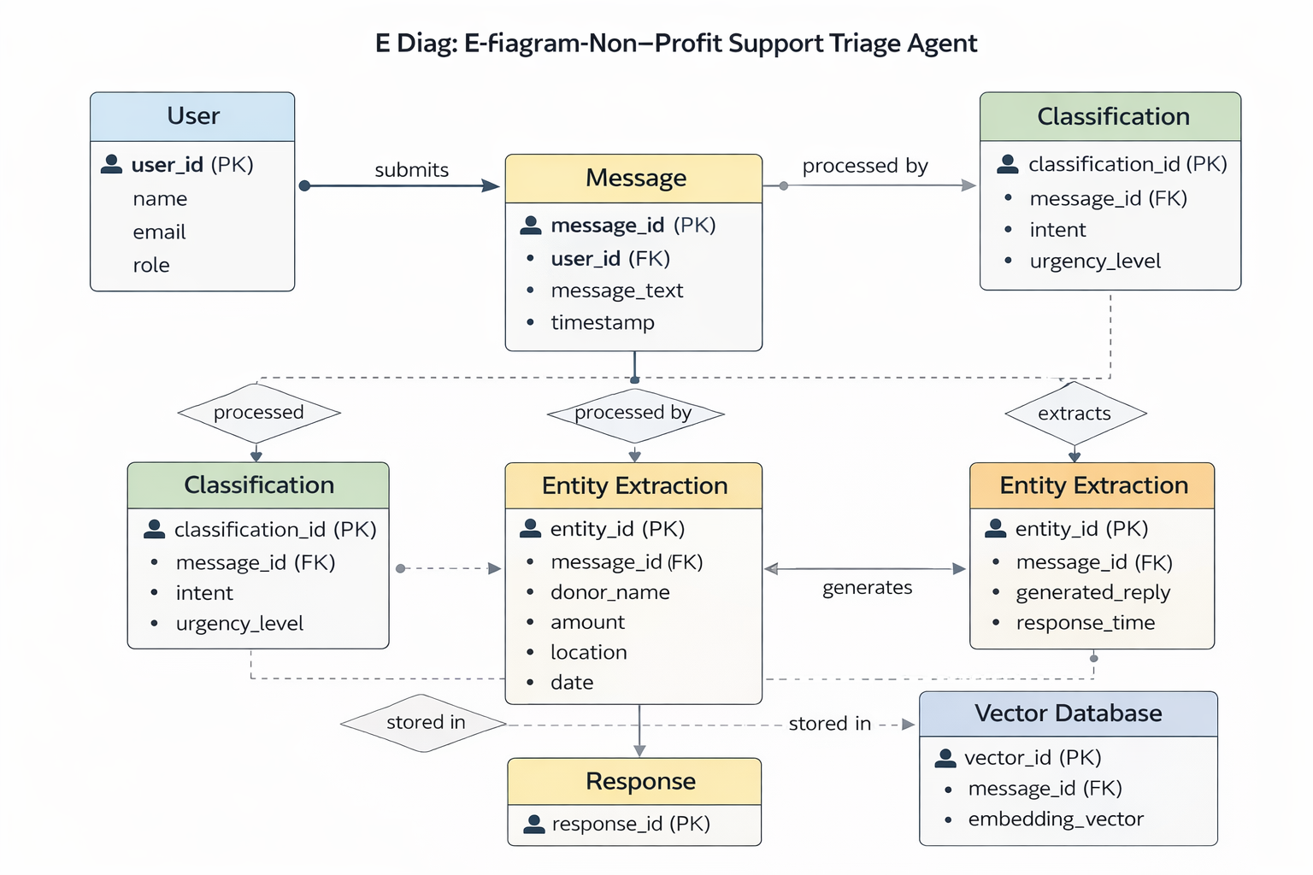
ER Diagram

Slide 9
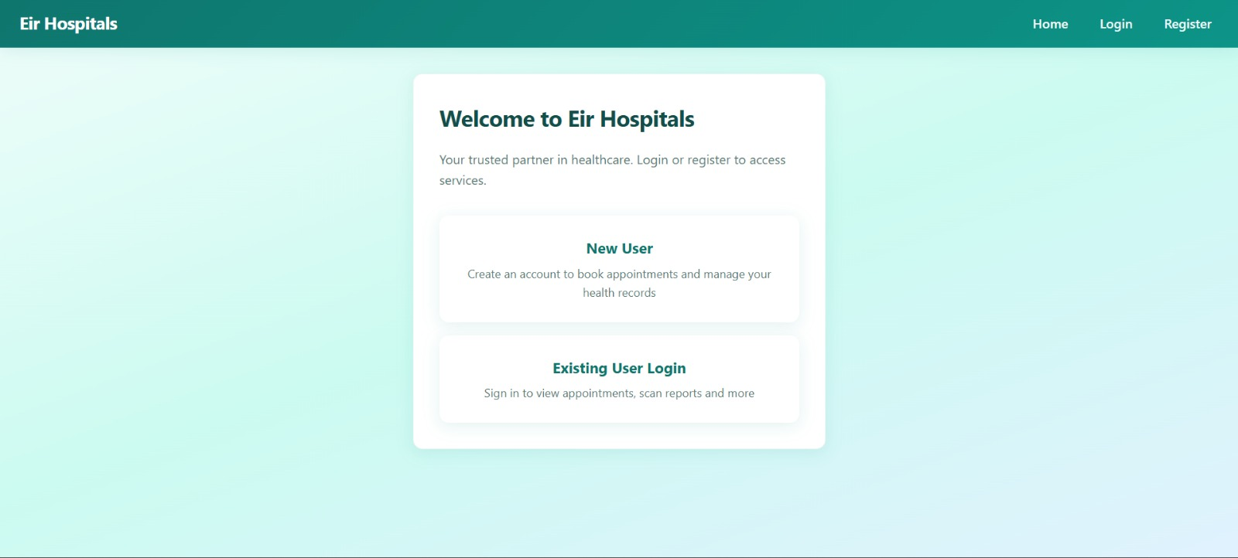
Snapshots

Slide 10
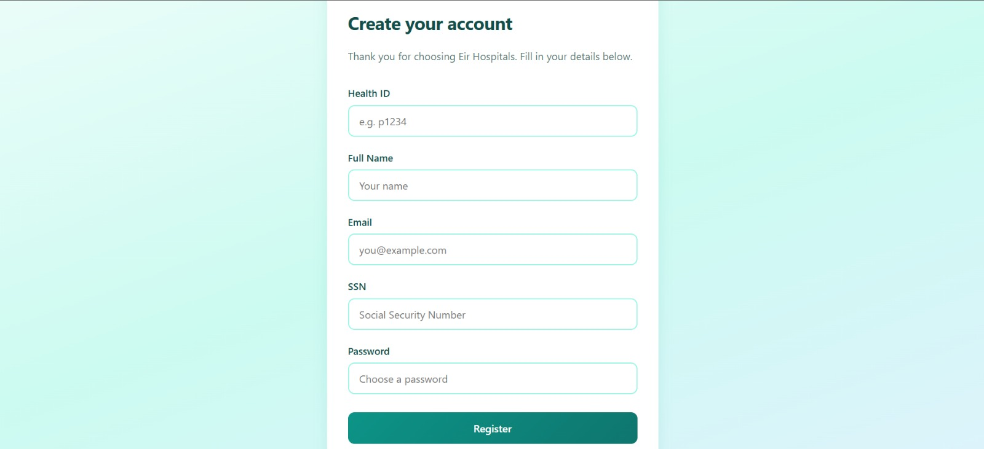
Snapshots

Slide 11
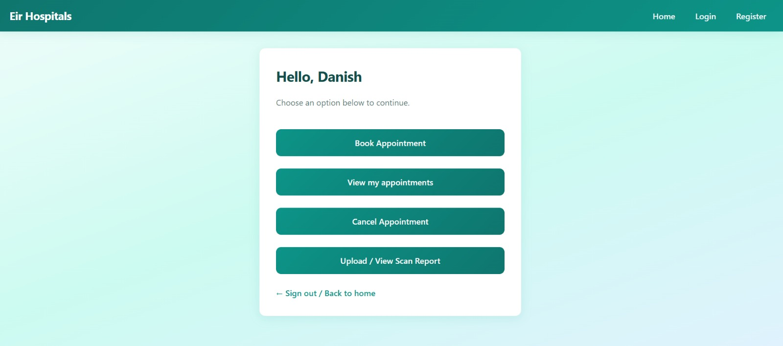
Snapshots

Slide 12
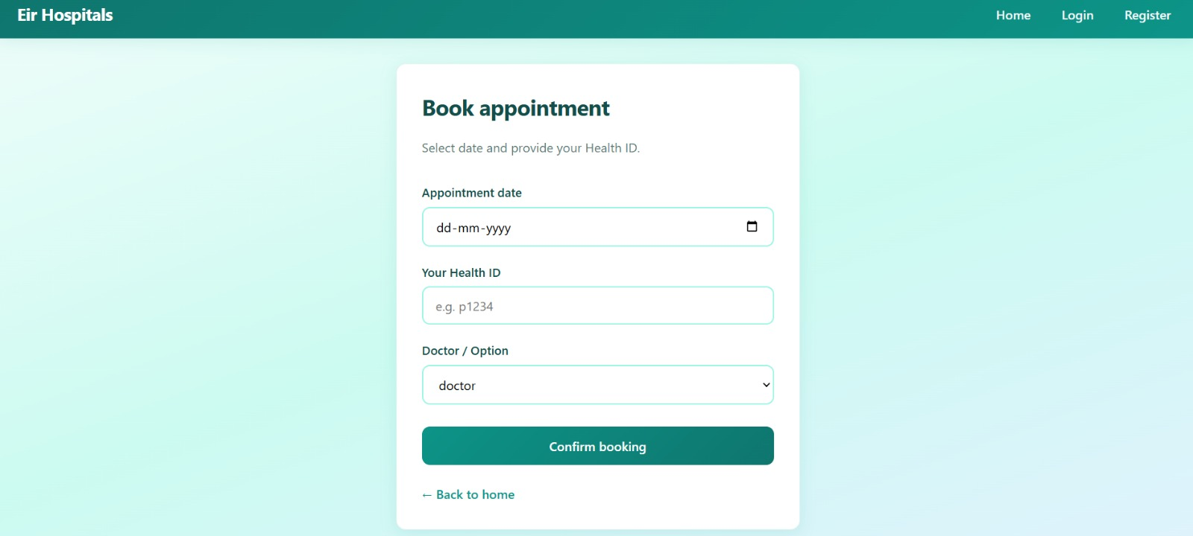
Snapshots

Slide 13
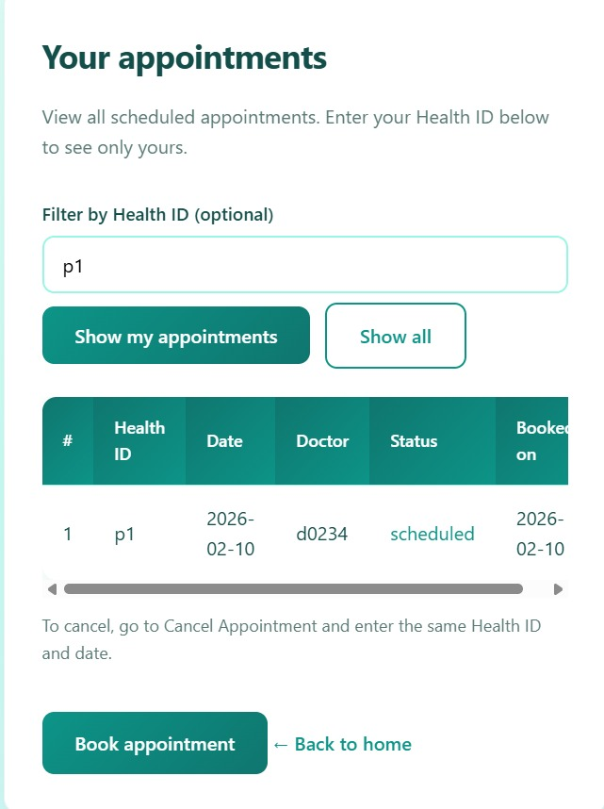
Snapshots

Slide 14
Thank You

